Slide 1
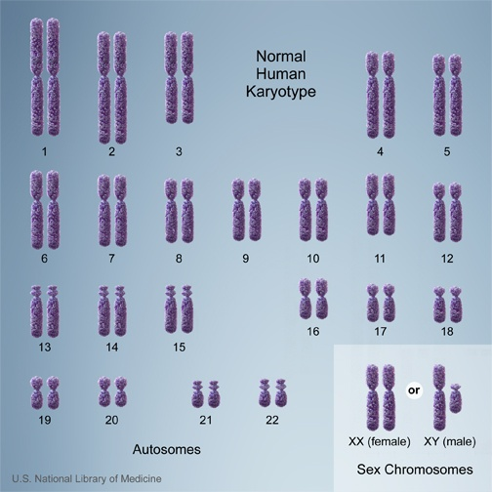
Diploid: cell containing 2 pairs of chromosomes (homologous). One set from each parent
One chromosome is from dad other from mom
Have the same genes for the same traits in the same order.

Slide 2
Meiosis
Cell division where new cells have half the number of chromosomes as original
Haploid (n): a cell containing one set of chromosomes.

Slide 3
Meiosis
Results in new cells called gametes (sex cells).
Sperm and egg (animals), pollen and seeds (plants)
Occurs only in specialized body cells
Used to increase genetic variation of species by combining half of the genes from the fathers lineage and half from mothers.

Slide 4
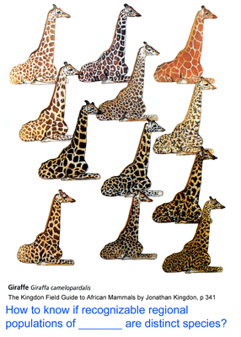
Why is genetic variation important?

Slide 5
Endless possibilities!
8,388,604 possible combinations of chromosomes from one parent.
Any couple could have 2²³ × 2²³ or 70,368,744,177,644 (70 trillion) different possible children, based just on the number of chromosomes, not considering the actual genes on those chromosomes. Thus, the chance of two siblings being exactly identical would be 1 in 70 trillion

Slide 6
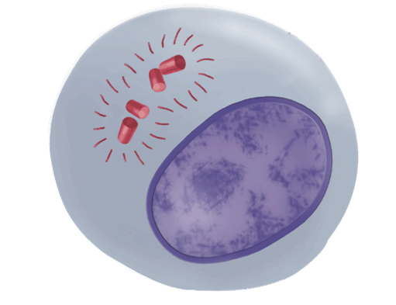
Phases of Meiosis
Cells undergo a round of DNA replication, forming duplicate chromosomes.
Interphase I
Notes:
Interphase I - Cells undergo a round of DNA replication, forming duplicate chromosomes.

Slide 7
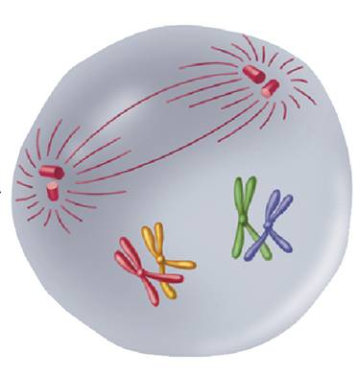
Phases of Meiosis
Nuclear envelope breaks down
Centrioles go to poles
Spindle fibers form
Each chromosome pairs with its corresponding homologous chromosome.
MEIOSIS I
Prophase I
Notes:
MEIOSIS I Prophase I - Each chromosome pairs with its corresponding homologous chromosome to form a tetrad.

Slide 8
Phases of Meiosis
When homologous chromosomes match up in meiosis I, they exchange portions of their chromatids in a process called crossing over.
Crossing-over produces new combinations of alleles.
Notes:
Crossing-over occurs during meiosis. (1) Homologous chromosomes form a tetrad. (2) Chromatids cross over one another. (3) The crossed sections of the chromatids are exchanged.

Slide 9
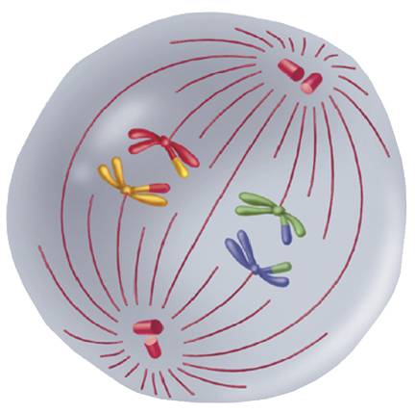
Phases of Meiosis
Homolougous chromosomes pair up and line up in middle
Spindle fibers attach to the chromosomes.
MEIOSIS I
Metaphase I
Notes:
MEIOSIS I Metaphase I - Spindle fibers attach to the chromosomes.

Slide 10
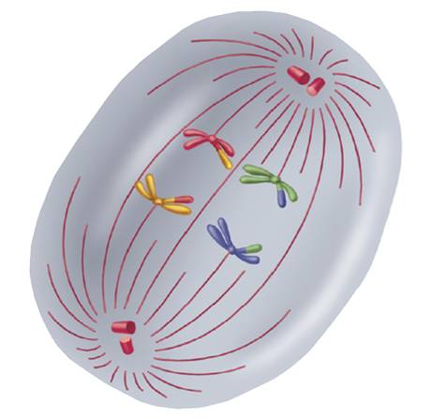
Phases of Meiosis
The fibers pull the homologous chromosomes toward opposite ends of the cell.
MEIOSIS I
Anaphase I
Notes:
MEIOSIS I Anaphase I - The fibers pull the homologous chromosomes toward opposite ends of the cell.

Slide 11
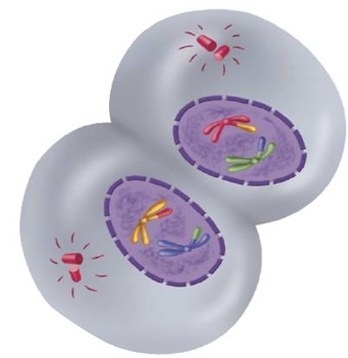
Phases of Meiosis
MEIOSIS I
Telophase I and
Cytokinesis
Telophase I
Nuclear membranes form.
Cleavage
Interkinesis
The cell separates into two cells.
The two cells produced by meiosis 1 have chromosomes and alleles that are different from each other and from the diploid cell that entered meiosis I.
Notes:
MEIOSIS I Telophase I and Cytokinesis - Nuclear membranes form. The cell separates into two cells.

Slide 12
Phases of Meiosis
Meiosis II
The two cells produced by meiosis I now enter a second meiotic division.
Unlike meiosis I, neither cell goes through chromosome replication.
Each of the cell’s chromosomes has 2 chromatids.

Slide 13
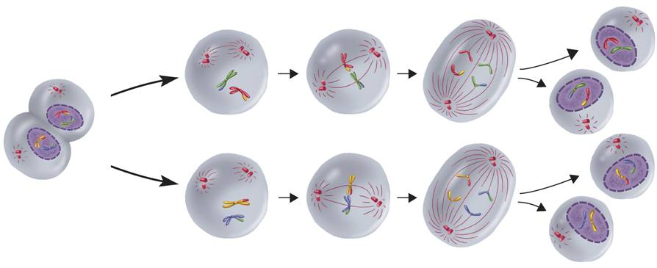
Phases of Meiosis
Meiosis II
Telophase I and Cytokinesis I
Meiosis II
Metaphase II
Anaphase II
Telophase II and Cytokinesis
Prophase II
Notes:
During meiosis, the number of chromosomes per cell is cut in half through the separation of the homologous chromosomes. The result of meiosis is 4 haploid cells that are genetically different from one another and from the original cell.

Slide 14
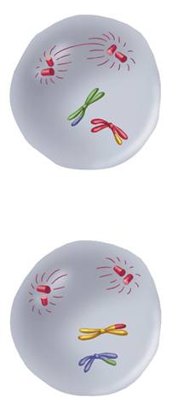
Phases of Meiosis
Meiosis I results in two (N) daughter cells.
Nuclear envelope breaks down
Centrioles go to poles
MEIOSIS II
Prophase II
Notes:
MEIOSIS II Prophase II - Meiosis I results in two haploid (N) daughter cells, each with half the number of chromosomes as the original cell.

Slide 15
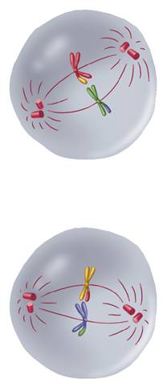
Phases of Meiosis
The chromosomes line up in the center of cell.
Spindle fibers attach to centromere
MEIOSIS II
Metaphase II
Notes:
MEIOSIS II Metaphase II - The chromosomes line up in a similar way to the metaphase state of mitosis.

Slide 16
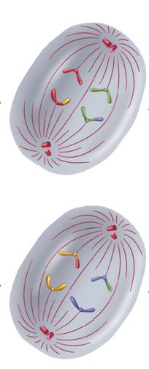
Phases of Meiosis
The sister chromatids separate and move toward opposite ends of the cell.
MEIOSIS II
Anaphase II
Notes:
MEIOSIS II Anaphase II - The sister chromatids separate and move toward opposite ends of the cell.

Slide 17
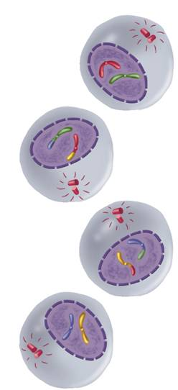
Phases of Meiosis
Telophase II
Nuclear envelope appears
Cleavage froms
Cytokinesis
Meiosis II results in four haploid (N) daughter cells.
MEIOSIS II
Telophase II and Cytokinesis
Notes:
MEIOSIS II Telophase II and Cytokinesis - Meiosis II results in four haploid (N) daughter cells.

Slide 18
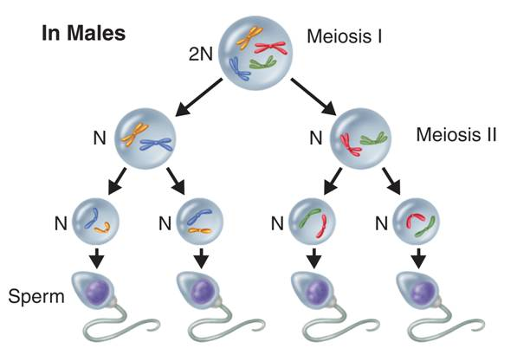
Gamete Formation
Gamete Formation
In male animals, meiosis results in four equal-sized gametes called sperm.
Notes:
Meiosis produces four genetically different haploid cells. In males, meiosis results in four equal-sized gametes called sperm.

Slide 19
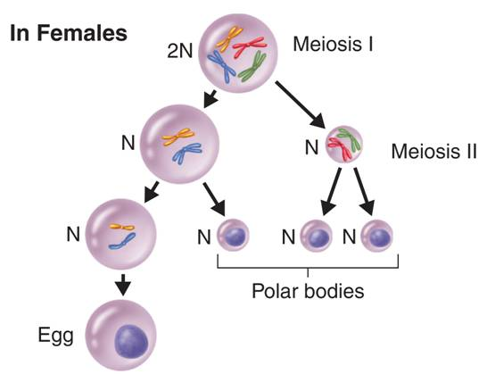
Gamete Formation
In many female animals, only one egg results from meiosis. The other three cells, called polar bodies, are usually not involved in reproduction.
Notes:
Meiosis produces four genetically different haploid cells. In females, only one large egg cell results from meiosis. The other three cells, called polar bodies, usually are not involved in reproduction.

